Slide 1


Computer Networks
Lecture (Chapter2)
Application Layer
Subhan Ullah, PhD
subhan.ullah@nu.edu.pk
BS(Computer Science) Fall-2022

Slide 2


Maintaining user/server state: cookies
Recall: HTTP GET/response interaction is stateless
no notion of multi-step exchanges of HTTP messages to complete a Web “transaction”
no need for client/server to track “state” of multi-step exchange
all HTTP requests are independent of each other
no need for client/server to “recover” from a partially-completed-but-never-completely-completed transaction
a stateful protocol: client makes two changes to X, or none at all
X
lock data record X
X
OK
update X X’
X’
OK
t’
update X X’’
OK
X’’
unlock X
OK
X’’
time
time
Q: what happens if network connection or client crashes at t’ ?
Notes:
t’

Slide 3
Maintaining user/server state: cookies
Web sites and client browser use cookies to maintain some state between transactions
four components:
1) cookie header line of HTTP response message
2) cookie header line in next HTTP request message
3) cookie file kept on user’s host, managed by user’s browser
4) back-end database at Web site
Example:
Susan uses browser on laptop, visits specific e-commerce site for first time
when initial HTTP requests arrives at site, site creates:
unique ID (aka “cookie”)
entry in backend database for ID
subsequent HTTP requests from Susan to this site will contain cookie ID value, allowing site to “identify” Susan
Notes:
t’

Slide 4
Maintaining user/server state: cookies
client
server
ebay 8734
usual HTTP request msg
Amazon server
creates ID
1678 for user
cookie file
usual HTTP response
set-cookie: 1678
backend
database
create
entry
ebay 8734
amazon 1678
usual HTTP request msg
cookie: 1678
cookie-
specific
action
access
usual HTTP response msg
one week later:
access
ebay 8734
amazon 1678
usual HTTP request msg
cookie: 1678
cookie-
specific
action
usual HTTP response msg
time
time
Notes:
t’

Slide 5
HTTP cookies: comments
aside
What cookies can be used for:
authorization
shopping carts
recommendations
user session state (Web e-mail)
cookies and privacy:
cookies permit sites to learn a lot about you on their site.
third party persistent cookies (tracking cookies) allow common identity (cookie value) to be tracked across multiple web sites
Challenge: How to keep state?
at protocol endpoints: maintain state at sender/receiver over multiple transactions
in messages: cookies inHTTP messages carry state
Notes:
t’

Slide 6

Web caches
Goal: satisfy client requests without involving origin server
user configures browser to point to a (local) Web cache
browser sends all HTTP requests to cache
if object in cache: cache returns object to client
else cache requests object from origin server, caches received object, then returns object to client
Web
cache
HTTP request
HTTP request
client
HTTP response
HTTP response
origin
server
HTTP request
HTTP response
client
Notes:
t’

Slide 7
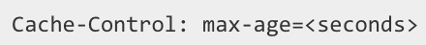

Web caches (aka proxy servers)
Web cache acts as both client and server
server for original requesting client
client to origin server
Why Web caching?
reduce response time for client request
cache is closer to client
reduce traffic on an institution’s access link
Internet is dense with caches
enables “poor” content providers to more effectively deliver content
server tells cache about object’s allowable caching in response header:
Notes:
re: poor content providers – like in real-estate, location is everything. servers want to be close to clients.

Slide 8
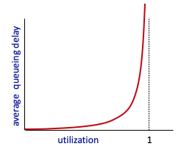


Caching example
Scenario:
access link rate: 1.54 Mbps
RTT from institutional router to server: 2 sec
web object size: 100K bits
average request rate from browsers to origin servers: 15/sec
avg data rate to browsers: 1.50 Mbps
origin
servers
public
Internet
1.54 Mbps
access link
Performance:
access link utilization = .97
LAN utilization: .0015
end-end delay = Internet delay +
access link delay + LAN delay
= 2 sec + minutes + usecs
problem: large queueing delays at high utilization!
institutional
network
1 Gbps LAN
Notes:
explain why minutes (recall earlier delay versus arrival rate curve from Chapter 1)
Total data request is 15*100 kb= 1500K bits
Average data rate = 1500K b/s 0r 1500/1000 Mbps = 1.50 Mbps
Access link utilization: 1.50/1.54 =97.4….
LAN utilization: 1.50/1 Gbps= 1.5/1000 mbps= .0015 mbps

Slide 9
Option 1: buy a faster access link
Scenario:
access link rate: 1.54 Mbps
RTT from institutional router to server: 2 sec
web object size: 100K bits
average request rate from browsers to origin servers: 15/sec
avg data rate to browsers: 1.50 Mbps
154 Mbps
origin
servers
public
Internet
154 Mbps
1.54 Mbps
access link
Performance:
access link utilization = .97
LAN utilization: .0015
end-end delay = Internet delay +
access link delay + LAN delay
= 2 sec + minutes + usecs
.0097
institutional
network
1 Gbps LAN
Cost: faster access link (expensive!)
msecs
Notes:
t’

Slide 10
Option 2: install a web cache
Scenario:
access link rate: 1.54 Mbps
RTT from institutional router to server: 2 sec
web object size: 100K bits
average request rate from browsers to origin servers: 15/sec
avg data rate to browsers: 1.50 Mbps
origin
servers
public
Internet
1.54 Mbps
access link
Cost: web cache (cheap!)
institutional
network
Performance:
LAN utilization: .?
access link utilization = ?
average end-end delay = ?
1 Gbps LAN
How to compute link
utilization, delay?
local web cache
Notes:
t’

Slide 11
Calculating access link utilization, end-end delay with cache:
suppose cache hit rate is 0.4:
40% requests served by cache, with low (msec) delay
origin
servers
public
Internet
60% requests satisfied at origin
rate to browsers over access link
= 0.6 * 1.50 Mbps = .9 Mbps
access link utilization = 0.9/1.54 = .58 means low (msec) queueing delay at access link
1.54 Mbps
access link
institutional
network
average end-end delay:
= 0.6 * (delay from origin servers)
+ 0.4 * (delay when satisfied at cache)
= 0.6 (2.01) + 0.4 (~msecs) = ~ 1.2 secs
1 Gbps LAN
local web cache
lower average end-end delay than with 154 Mbps link (and cheaper too!)
Notes:
t’

Slide 12
Conditional GET
client
server
Goal: don’t send object if cache has up-to-date cached version
no object transmission delay (or use of network resources)
client: specify date of cached copy in HTTP request
If-modified-since: <date>
server: response contains no object if cached copy is up-to-date:
HTTP/1.0 304 Not Modified
HTTP request msg
If-modified-since: <date>
object
not
modified
before
<date>
HTTP response
HTTP/1.0
304 Not Modified
HTTP request msg
If-modified-since: <date>
object
modified
after
<date>
HTTP response
HTTP/1.0 200 OK
<data>
Notes:
t’

Slide 13
HTTP/2
Key goal: decreased delay in multi-object HTTP requests
HTTP1.1: introduced multiple, pipelined GETs over single TCP connection
server responds in-order (FCFS: first-come-first-served scheduling) to GET requests
with FCFS, small object may have to wait for transmission (head-of-line (HOL) blocking) behind large object(s)
loss recovery (retransmitting lost TCP segments) stalls object transmission
Notes:
t’

Slide 14
HTTP/2
Key goal: decreased delay in multi-object HTTP requests
HTTP/2: [RFC 7540, 2015] increased flexibility at server in sending objects to client:
methods, status codes, most header fields unchanged from HTTP 1.1
transmission order of requested objects based on client-specified object priority (not necessarily FCFS)
push unrequested objects to client
divide objects into frames, schedule frames to mitigate HOL blocking
Notes:
t’

Slide 15
HTTP/2: mitigating HOL blocking
HTTP 1.1: client requests 1 large object (e.g., video file) and 3 smaller objects
server
GET O₄
GET O₃
GET O₂
GET O₁
object data requested
client
O₁
O₂
O₁
O₃
O₂
O₃
O₄
O₄
objects delivered in order requested: O₂, O₃, O₄ wait behind O₁
Notes:
t’

Slide 16
HTTP/2: mitigating HOL blocking
HTTP/2: objects divided into frames, frame transmission interleaved
server
GET O₄
GET O₃
GET O₂
GET O₁
object data requested
client
O₂
O₄
O₃
O₁
O₂
O₃
O₄
O₁
O₂, O₃, O₄ delivered quickly, O₁ slightly delayed
Notes:
shortest job first: decreased average delay!

Slide 17
HTTP/2 to HTTP/3
HTTP/2 over single TCP connection means:
recovery from packet loss still stalls all object transmissions
as in HTTP 1.1, browsers have incentive to open multiple parallel TCP connections to reduce stalling, increase overall throughput
no security over vanilla TCP connection
HTTP/3: adds security, per object error- and congestion-control (more pipelining) over UDP
more on HTTP/3 in transport layer
Notes:
Vanilla is an ordinary connection, with no special or extra features.

Slide 18

Application layer: overview
Principles of network applications
Web and HTTP
E-mail, SMTP, IMAP, FTP
The Domain Name System DNS

Slide 20
E-mail
user
agent
Three major components:
user agents
mail servers
simple mail transfer protocol: SMTP
User Agent
a.k.a. “mail reader”
composing, editing, reading mail messages
e.g., Outlook, iPhone mail client
outgoing, incoming messages stored on server
mail
server
user
agent
SMTP
mail
server
user
agent
SMTP
SMTP
user
agent
mail
server
user
agent
user
agent
outgoing
message queue
user mailbox

Slide 21
E-mail: mail servers
user
agent
mail servers:
mailbox contains incoming messages for user
message queue of outgoing (to be sent) mail messages
SMTP protocol between mail servers to send email messages
client: sending mail server
“server”: receiving mail server
mail
server
user
agent
SMTP
mail
server
user
agent
SMTP
SMTP
user
agent
mail
server
user
agent
user
agent
outgoing
message queue
user mailbox

Slide 22
SMTP RFC (5321)
“client”
SMTP server
“server”
SMTP server
uses TCP to reliably transfer email message from client (mail server initiating connection) to server, port 25
direct transfer: sending server (acting like client) to receiving server
three phases of transfer
SMTP handshaking (greeting)
SMTP transfer of messages
SMTP closure
command/response interaction (like HTTP)
commands: ASCII text
response: status code and phrase
initiate TCP
connection
RTT
TCP connection
initiated
220
SMTP handshaking
HELO
250 Hello
SMTP transfers
time
Notes:
MIME: Multipurpose Internet Mail Extensions (MIME) is an Internet standard that extends the format of email messages to support text in character sets other than ASCII, as well as attachments of audio, video, images, and application programs.

Slide 23


Scenario: Alice sends e-mail to Bob
1) Alice uses UA to compose e-mail message “to” bob@someschool.edu
4) SMTP client sends Alice’s message over the TCP connection
2) Alice’s UA sends message to her mail server using SMTP; message placed in message queue
5) Bob’s mail server places the message in Bob’s mailbox
3) client side of SMTP at mail server opens TCP connection with Bob’s mail server
6) Bob invokes his user agent to read message
user
agent
mail
server
user
agent
1
mail
server
2
3
6
4
Alice’s mail server
5
Bob’s mail server

Slide 24
Sample SMTP interaction
S: 220 hamburger.edu
C: HELO crepes.fr
S: 250 Hello crepes.fr, pleased to meet you
C: MAIL FROM: <alice@crepes.fr>
S: 250 alice@crepes.fr... Sender ok
C: RCPT TO: <bob@hamburger.edu>
S: 250 bob@hamburger.edu ... Recipient ok
C: DATA
S: 354 Enter mail, end with "." on a line by itself
C: Do you like ketchup?
C: How about pickles?
C: .
S: 250 Message accepted for delivery
C: QUIT
S: 221 hamburger.edu closing connection

Slide 25
SMTP: observations
comparison with HTTP:
HTTP: client pull
SMTP: client push
both have ASCII command/response interaction, status codes
HTTP: each object encapsulated in its own response message
SMTP: multiple objects sent in multipart message
SMTP uses persistent connections
SMTP requires message (header & body) to be in 7-bit ASCII
SMTP server uses CRLF.CRLF to determine end of message
Notes:
Carriage Return Line Feed (CRLF).

Slide 26
Mail message format
SMTP: protocol for exchanging e-mail messages, defined in RFC 5321 (like RFC 7231 defines HTTP)
RFC 2822 defines syntax for e-mail message itself (like HTML defines syntax for web documents)
header lines, e.g.,
To:
From:
Subject:
these lines, within the body of the email message area different from SMTP MAIL FROM:, RCPT TO: commands!
Body: the “message” , ASCII characters only
header
blank
line
body
Notes:
>nslookup -type=MX subhan.ullah@nu.edu.pk

Slide 27
Retrieving email: mail access protocols
user
agent
e-mail access
protocol
user
agent
SMTP
SMTP
(e.g., IMAP, HTTP)
sender’s e-mail
server
receiver’s e-mail
server
SMTP: delivery/storage of e-mail messages to receiver’s server
mail access protocol: retrieval from server
IMAP: Internet Mail Access Protocol [RFC 3501]: messages stored on server, IMAP provides retrieval, deletion, folders of stored messages on server
HTTP: gmail, Hotmail, Yahoo!Mail, etc. provides web-based interface on top of STMP (to send), IMAP (or POP) to retrieve e-mail messages

Slide 28
FTP: the file transfer protocol
file transfer
FTP
user
interface
FTP
client
FTP
server
user
at host
remote file
system
local file
system
transfer file to/from remote host
client/server model
client: side that initiates transfer (either to/from remote)
server: remote host
ftp: RFC 959
ftp server: port 21

Slide 29
FTP: separate control, data connections
TCP control connection,
server port 21
FTP client contacts FTP server at port 21, using TCP
client authorized over control connection
client browses remote directory, sends commands over control connection (username and password, commands to change remote directory, and commands to “put” and “get” files)
when server receives file transfer command, server opens 2nd TCP data connection (for file) to client
after transferring one file, server closes data connection
FTP
client
TCP data connection,
server port 20
FTP
server
server opens another TCP data connection to transfer another file
control connection: “out of band”
FTP server maintains “state”: current directory, earlier authentication
HTTP “in-band” sends request and response header lines into the same TCP connection that carries the transferred file itself

Slide 30
FTP commands, responses
sample commands:
sent as ASCII text over control channel
USER username
PASS password
LIST return list of file in current directory
RETR filename retrieves (gets) file
STOR filename stores (puts) file onto remote host
sample return codes
status code and phrase (as in HTTP)
331 Username OK, password required
125 data connection already open; transfer starting
425 Can’t open data connection
452 Error writing file
FTP in 2021: Top Examples of Common & Unique Uses
https://www.exavault.com/blog/ftp-in-action-newsletter

Slide 31
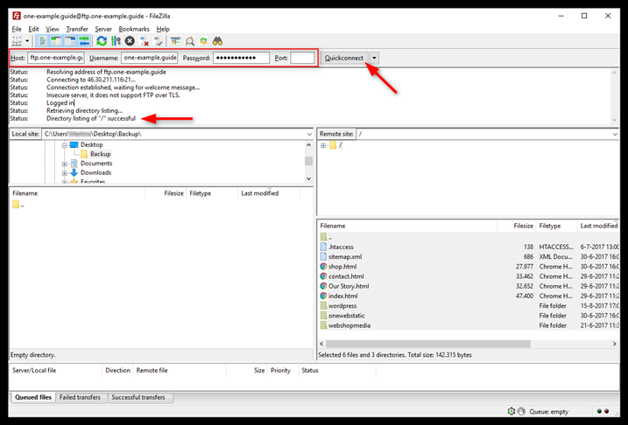
Login Filezilla via FTP
Notes:
Filezilla
Host = ftp.yourdomain.com Username = yourdomain.com Password = The password you chose under FTP & SSH

Slide 32
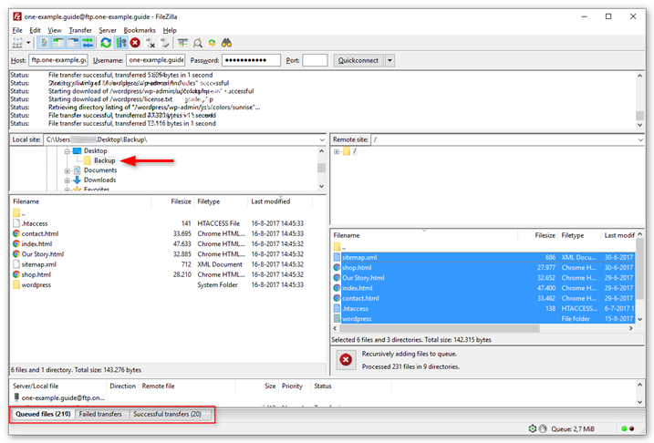
Accessing files from website using Filezilla

Slide 33
Application Layer: Overview
Principles of network applications
Web and HTTP
E-mail, SMTP, IMAP, FTP
The Domain Name System DNS

Slide 34
DNS: Domain Name System
people: many identifiers:
SSN, name, passport #
Internet hosts, routers:
IP address (32 bit) - used for addressing datagrams
“name”, e.g., cs.umass.edu - used by humans
Q: how to map between IP address and name, and vice versa ?
Domain Name System (DNS):
distributed database implemented in hierarchy of many name servers
application-layer protocol: hosts, DNS servers communicate to resolve names (address/name translation)
note: core Internet function, implemented as application-layer protocol
complexity at network’s “edge”

Slide 35
DNS: services, structure
DNS services:
hostname-to-IP-address translation
host aliasing
canonical, alias names
mail server aliasing
load distribution
replicated Web servers: many IP addresses correspond to one name
Q: Why not centralize DNS?
single point of failure
traffic volume
distant centralized database
maintenance
A: doesn‘t scale!
Comcast DNS servers alone: 600B DNS queries/day
Akamai DNS servers alone: 2.2T DNS queries/day
Notes:
Relay1.west-coast.yahoo.com
Comcast Corporation is an American multinational telecommunications conglomerate headquartered in Philadelphia, Pennsylvania.
dns port 53.

Slide 36
Host Aliasing
A host with a complicated hostname can have one or more alias names
For example, a hostname such as relay1.west-coast.enterprise.com could have, say, two aliases such as enterprise.com and www.enterprise.com.
How are these hosts related?
slate.nu.edu.pk
flex.nu.edu.pk
hr.nu.edu.pk
They all belong to the same country
How are these hosts related?
hr.nu.edu.pk
flex.nu.edu.pk
slate.nu.edu.pk
They all belong to the same organization, nu.

Slide 37
A unique host
slate.nu.edu
This is the domain name of a unique host. It is a member of the nu.edu domain, but it is the only one with the name slate.
It is like a family – all the brothers and sisters have the same last name, but it would be confusing if two of them also had the same first name.

Slide 38

Thinking about the DNS
humongous distributed database:
~ billion records, each simple
handles many trillions of queries/day:
many more reads than writes
performance matters: almost every Internet transaction interacts with DNS - msecs count!
organizationally, physically decentralized:
millions of different organizations responsible for their records
“bulletproof”: reliability, security

Slide 39
DNS: a distributed, hierarchical database
Root DNS Servers
Root
…
…
.com DNS servers
.org DNS servers
.edu DNS servers
Top Level Domain
…
…
…
…
yahoo.com
DNS servers
amazon.com
DNS servers
pbs.org
DNS servers
nyu.edu
DNS servers
umass.edu
DNS servers
Authoritative
Client wants IP address for www.amazon.com; 1st approximation:
client queries root server to find .com DNS server
client queries .com DNS server to get amazon.com DNS server
client queries amazon.com DNS server to get IP address for www.amazon.com

Slide 40
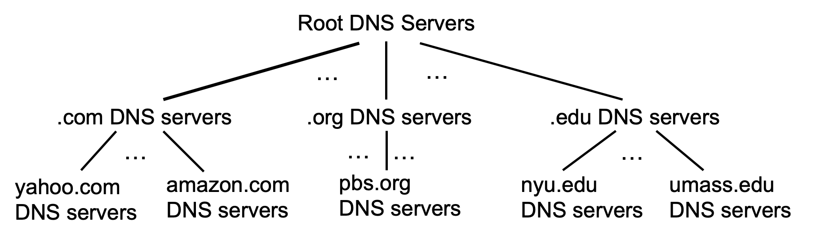
DNS: root name servers
official, contact-of-last-resort by name servers that can not resolve name

Slide 41
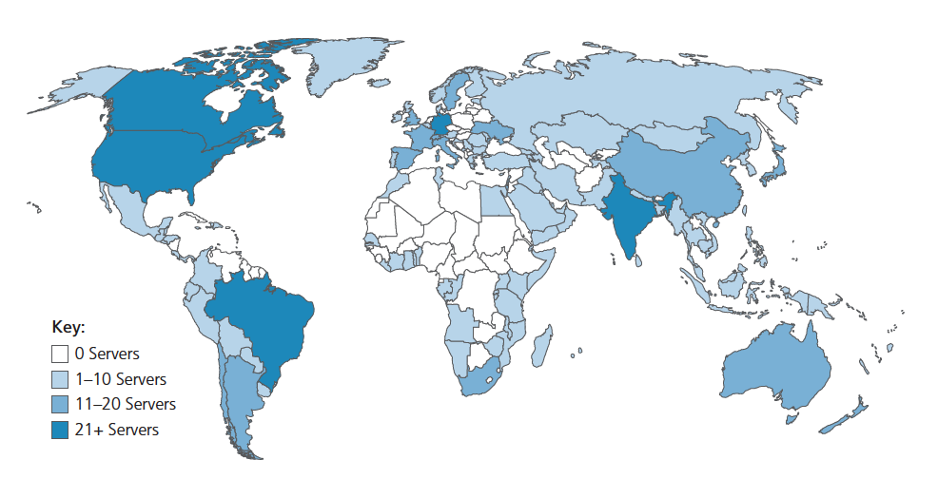
DNS: root name servers
official, contact-of-last-resort by name servers that can not resolve name
incredibly important Internet function
Internet couldn’t function without it!
DNSSEC – provides security (authentication, message integrity)
ICANN (Internet Corporation for Assigned Names and Numbers) manages root DNS domain
13 logical root name “servers” worldwide each “server” replicated many times (~200 servers in US)
Notes:
400 root name servers scattered all over the world. 13 different organizations manage them and their IP addresses.

Slide 42
Top-Level Domain, and authoritative servers
Top-Level Domain (TLD) servers:
responsible for .com, .org, .net, .edu, .aero, .jobs, .museums, and all top-level country domains, e.g.: .cn, .uk, .fr, .ca, .jp
Network Solutions: authoritative registry for .com, .net TLD
Educause: .edu TLD
authoritative DNS servers:
organization’s own DNS server(s), providing authoritative hostname to IP mappings for organization’s named hosts
can be maintained by organization or service provider
Notes:
top-level domain (TLD) servers:
Network Solutions maintains servers for .com TLD
Responsible for:
.edu, educational
.com, commercial
.gov, government
.org, non profit
.net, networking organizations
These are called “generic” TLDs.

Slide 43
Local DNS name servers
when host makes DNS query, it is sent to its local DNS server
Local DNS server returns reply, answering:
from its local cache of recent name-to-address translation pairs (possibly out of date!)
forwarding request into DNS hierarchy for resolution
each ISP has local DNS name server; to find yours:
MacOS: % scutil --dns
Windows: >ipconfig /all
local DNS server doesn’t strictly belong to hierarchy

Slide 44
DNS name resolution: iterated query
root DNS server
Example: host at engineering.nyu.edu wants IP address for gaia.cs.umass.edu
2
3
TLD DNS server
Iterated query:
contacted server replies with name of server to contact
“I don’t know this name, but ask this server”
1
4
8
5
requesting host at
engineering.nyu.edu
local DNS server
dns.nyu.edu
gaia.cs.umass.edu
7
6
authoritative DNS server
dns.cs.umass.edu

Slide 45
DNS name resolution: recursive query
root DNS server
Example: host at engineering.nyu.edu wants IP address for gaia.cs.umass.edu
2
3
7
6
Recursive query:
puts burden of name resolution on contacted name server
heavy load at upper levels of hierarchy?
1
TLD DNS server
8
requesting host at
engineering.nyu.edu
local DNS server
dns.nyu.edu
5
4
gaia.cs.umass.edu
authoritative DNS server
dns.cs.umass.edu

Slide 46
Caching DNS Information
once (any) name server learns mapping, it caches mapping, and immediately returns a cached mapping in response to a query
caching improves response time
cache entries timeout (disappear) after some time (TTL)
TLD servers typically cached in local name servers
cached entries may be out-of-date
if named host changes IP address, may not be known Internet-wide until all TTLs expire!
best-effort name-to-address translation!

Slide 47
DNS records
DNS: distributed database storing resource records (RR)
RR format: (name, value, type, ttl)
type=A
name is hostname
value is IP address
type=CNAME
name is alias name for some “canonical” (the real) name
www.ibm.com is really servereast.backup2.ibm.com
value is canonical name
type=NS
name is domain (e.g., foo.com)
value is hostname of authoritative name server for this domain
type=MX
value is name of SMTP mail server associated with name

Slide 48
DNS protocol messages
DNS query and reply messages, both have same format:
2 bytes
2 bytes
message header:
identification: 16 bit # for query, reply to query uses same #
flags:
query or reply
recursion desired
recursion available
reply is authoritative
identification
flags
# questions
# answer RRs
# authority RRs
# additional RRs
questions (variable # of questions)
answers (variable # of RRs)
authority (variable # of RRs)
additional info (variable # of RRs)

Slide 49
DNS protocol messages
DNS query and reply messages, both have same format:
2 bytes
2 bytes
identification
flags
# questions
# answer RRs
# authority RRs
# additional RRs
name, type fields for a query
questions (variable # of questions)
RRs in response to query
answers (variable # of RRs)
records for authoritative servers
authority (variable # of RRs)
additional “ helpful” info that may be used
additional info (variable # of RRs)

Slide 50
Getting your info into the DNS
example: new startup “Network Utopia”
register name networkuptopia.com at DNS registrar (e.g., Network Solutions)
provide names, IP addresses of authoritative name server (primary and secondary)
registrar inserts NS, A RRs into .com TLD server:
(networkutopia.com, dns1.networkutopia.com, NS)
(dns1.networkutopia.com, 212.212.212.1, A)
create authoritative server locally with IP address 212.212.212.1
type A record for www.networkuptopia.com
type MX record for networkutopia.com

Slide 51
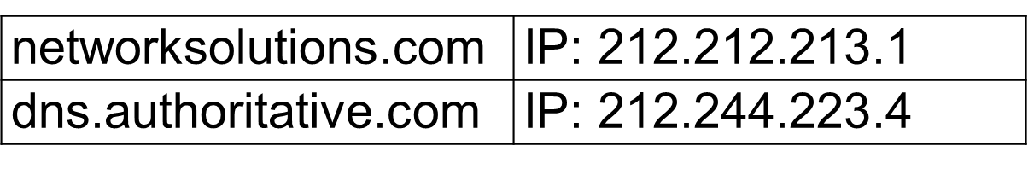
Task
You task is to register your new website (networksolutions.com). What specific records you need to add in the DNS hierarchy so that It can be accessed over the Internet

Slide 52
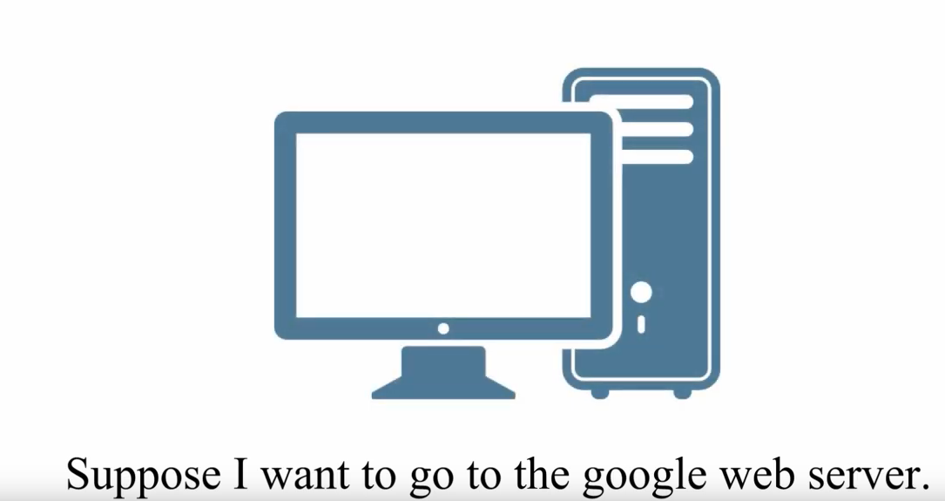
DNS walkthrough

Slide 53
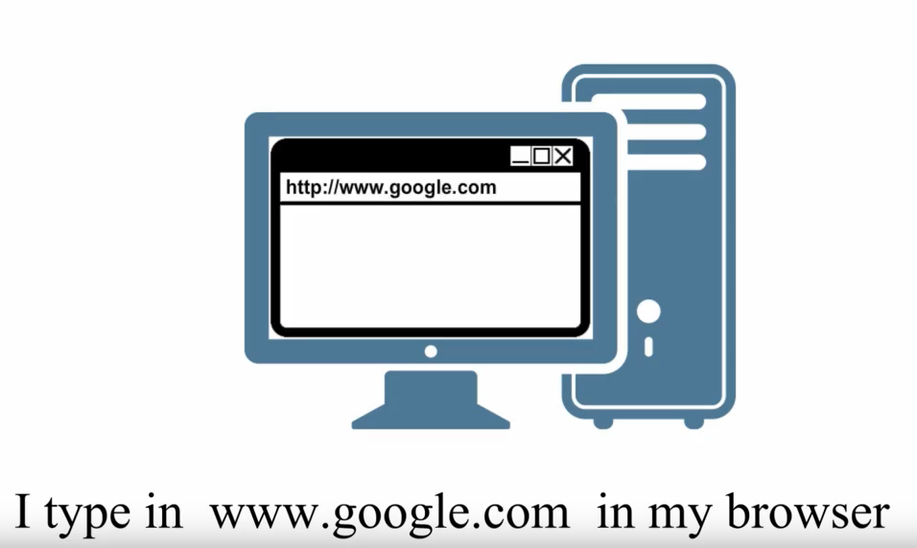
DNS walkthrough

Slide 54
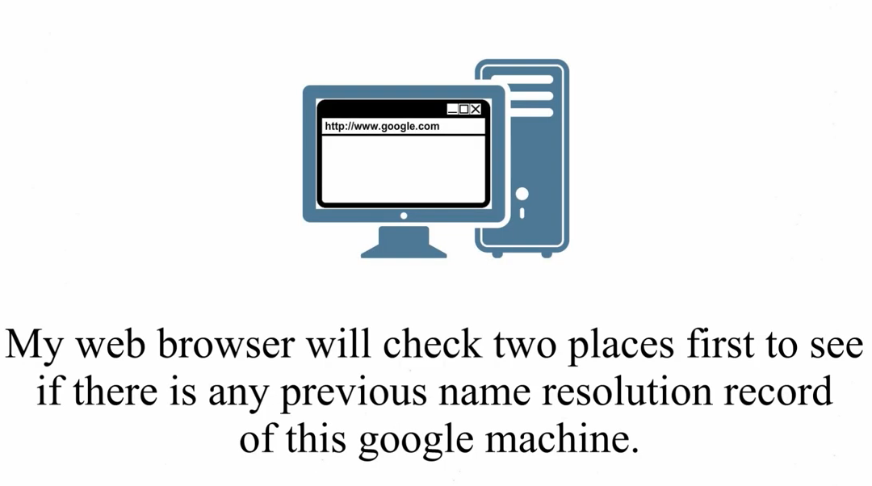
DNS walkthrough

Slide 55
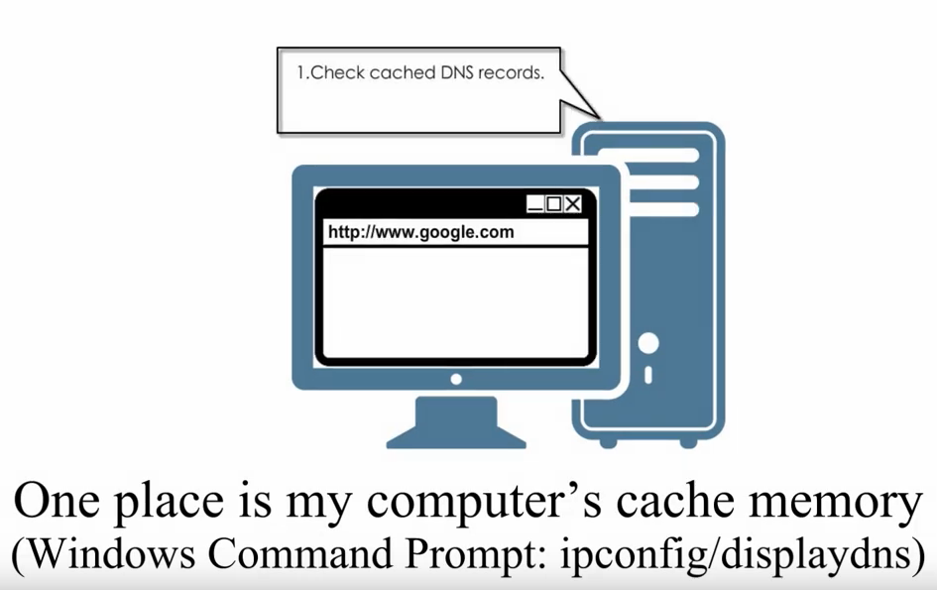
DNS walkthrough

Slide 56
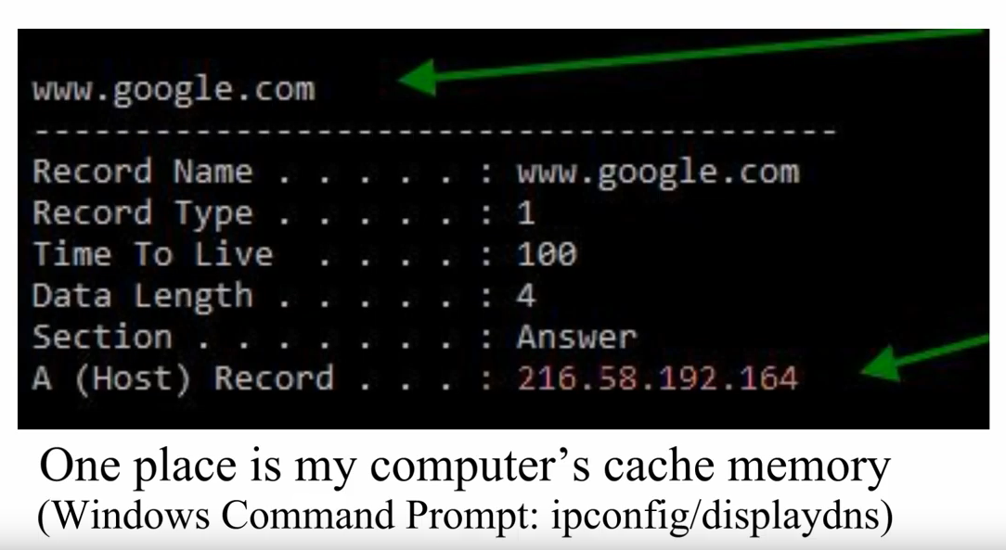
DNS walkthrough

Slide 57
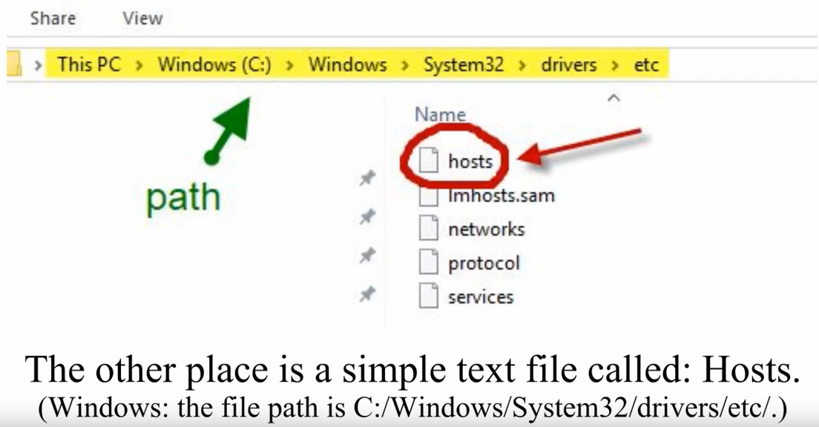
DNS walkthrough

Slide 58
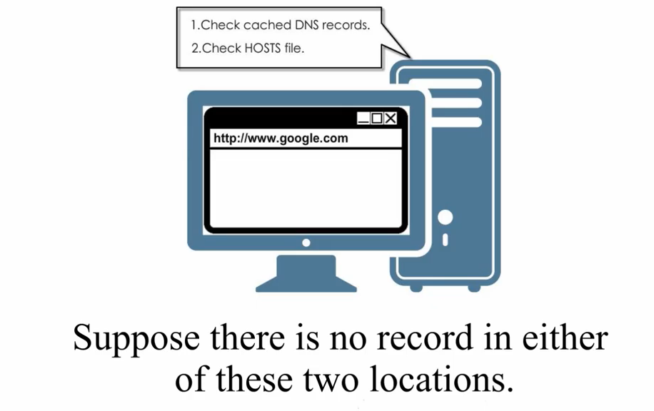
DNS walkthrough

Slide 59
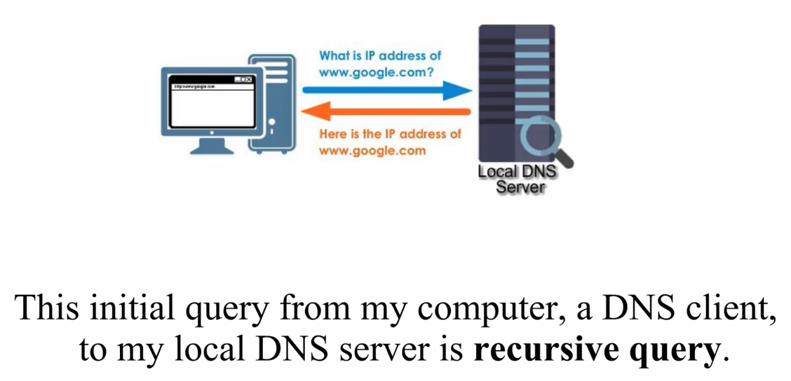
DNS walkthrough

Slide 60
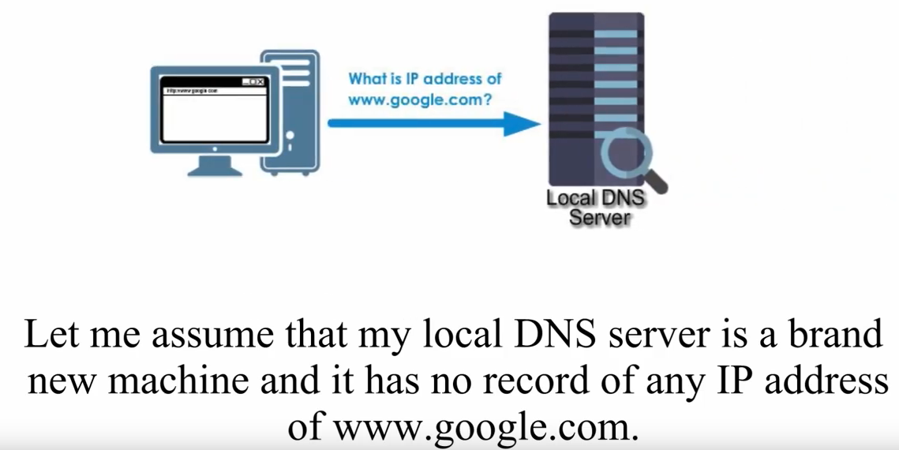
DNS walkthrough

Slide 61
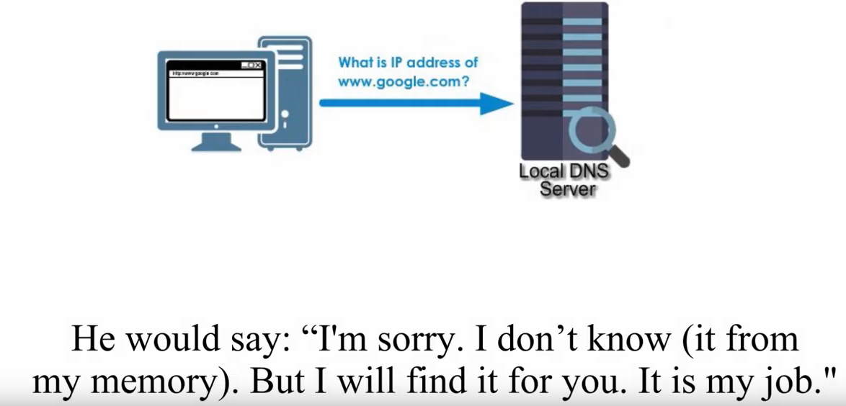
DNS walkthrough

Slide 62
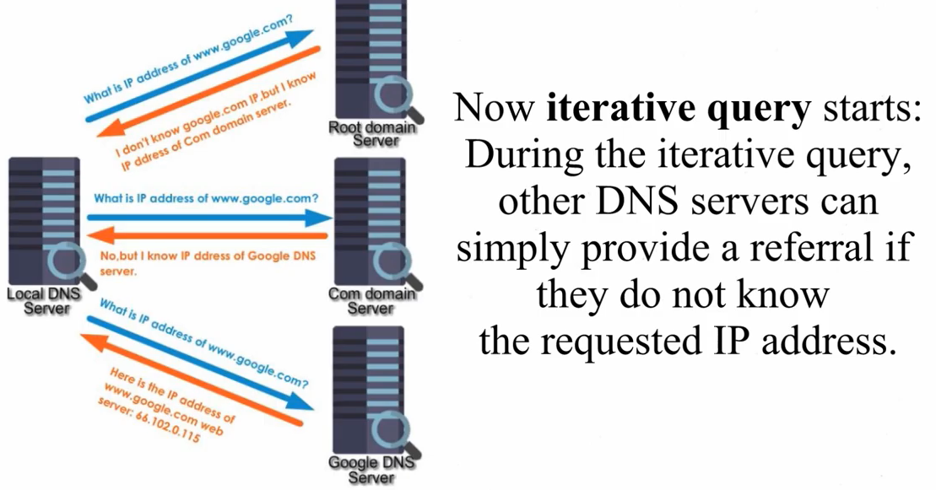
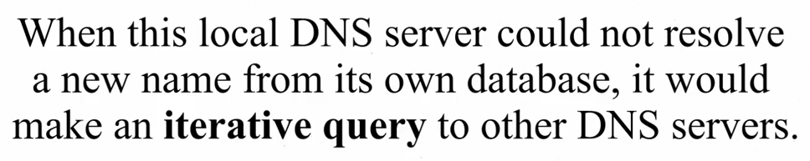
DNS walkthrough

Slide 63
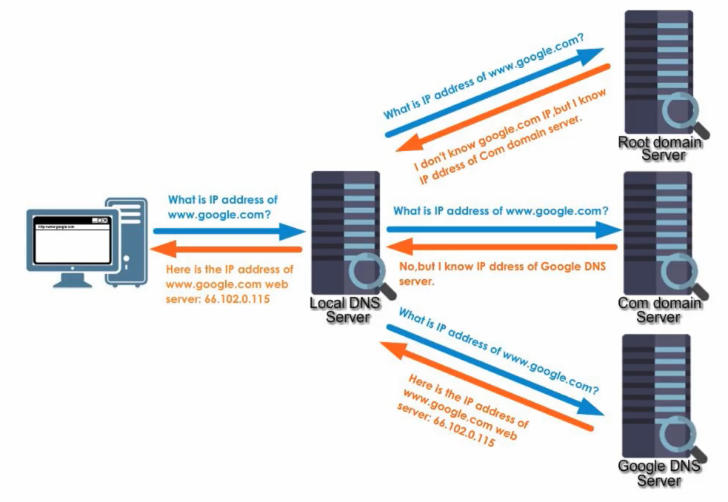
DNS walkthrough

Slide 64
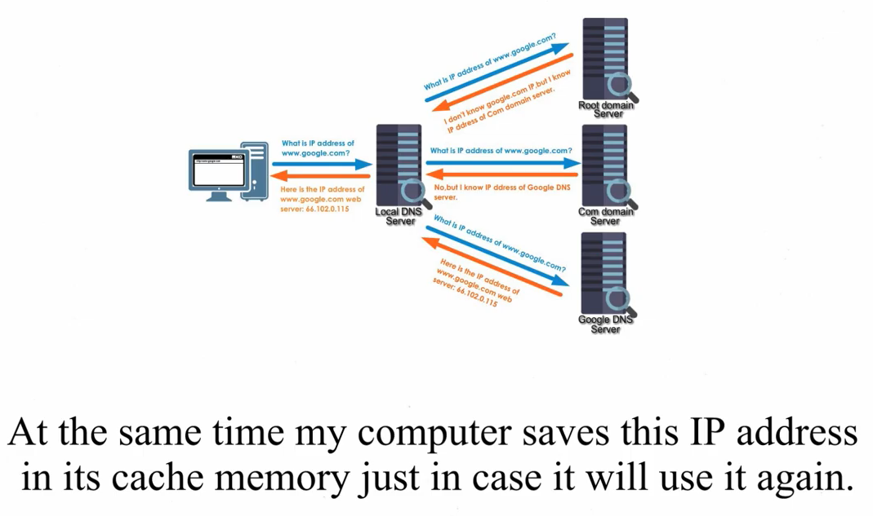
DNS walkthrough

Slide 65
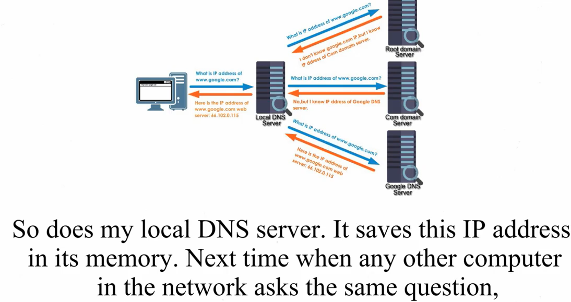
DNS walkthrough

Slide 66
DNS security
DDoS attacks
bombard root servers with traffic
not successful to date
traffic filtering
local DNS servers cache IPs of TLD servers, allowing root server bypass
bombard TLD servers
potentially more dangerous
Spoofing attacks
intercept DNS queries, returning bogus replies
DNS cache poisoning
RFC 4033: DNSSEC authentication services
Why did Facebook goes down 6th October 2021?
https://www.youtube.com/watch?v=Bie32IZlMtY

Slide 67
Chapter 2: Summary
our study of network application layer is now complete!
application architectures
client-server
P2P
application service requirements:
reliability, bandwidth, delay
Internet transport service model
connection-oriented, reliable: TCP
unreliable, datagrams: UDP
specific protocols:
HTTP
SMTP, IMAP
DNS

Slide 68
Chapter 2: Summary
Most importantly: learned about protocols!
typical request/reply message exchange:
client requests info or service
server responds with data, status code
message formats:
headers: fields giving info about data
data: info(payload) being communicated
important themes:
centralized vs. decentralized
stateless vs. stateful
scalability
reliable vs. unreliable message transfer
“complexity at network edge”
https://www.youtube.com/watch?v=kQmO_0mOwG4&list=PLBbU9-SUUCwVmwRswAHdqoJw-D2WeD9CN&index=25

Slide 69


Thank You All
☺
?
A note on the origin of these ppt slides:
All material copyright 1996-2020 J.F Kurose and K.W. Ross, All Rights Reserved
These slides are freely provided by the book authors and it represents a lot of work on their part. We would like to thank J.F Kurose and K.W. Ross.

